Slide 1
USEFUL JAPANESE DICTIONARY FOR VIETNAMESE
Supervisor: Nguyễn Văn Sang
Lê Đình Nam se02316
Phạm Thị Minh se02300
Phạm Tiến Đạt se02336
Nguyễn Ngọc Tuấn se02189

Slide 2
Problem Definition
The Idea
System purpose/ objective
Requirements
Functionalities

Slide 3
Problem Definition
Demand of learning Japanese high
Learning online
Nowadays, the relation of Vietnam and Japan is very good, Japan market need more human resource of Vietnam in many fields, special IT.
Have a lot of Japanese training center
With technology development, there are many websites to learn Japanese with many types and languages. Moreover it requests user upgrade account to learn.
Because number of people learn Japanese is crowd, series of centers are opened but they cannot control of training quality.

Slide 4
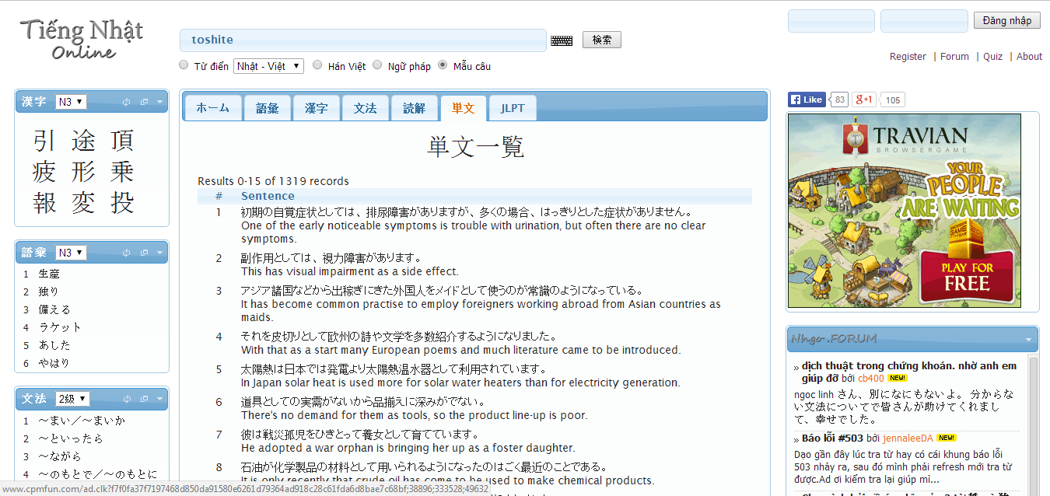
Problem Definition
With purpose is save time, many users choose study online likes a best way. But nowadays, have not website really good for Vietnamese.
Search with more option, but more words have not meaning with Vietnamese
Search Kanji, grammar
Post question
Do not support Viet-Nhat dictionary
Do not support listening, reading, conservation …

Slide 5
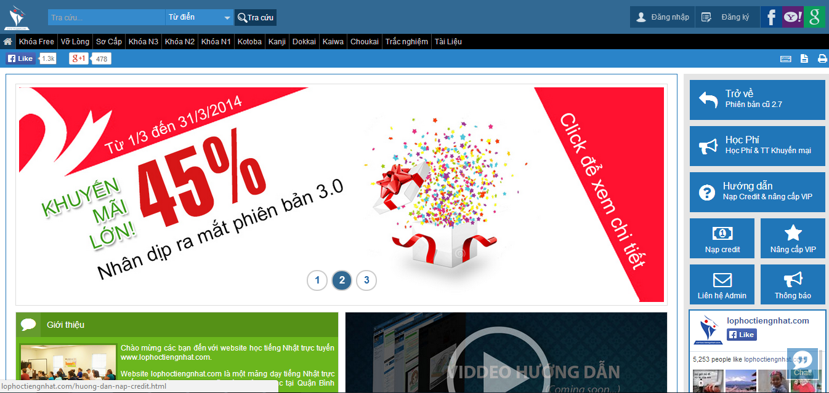
Problem Definition
Full support with listening, reading, conservation
Support search but too simple
Have to register and upgrade account to study

Slide 6
The idea
Reducing above gaps and integrating important function to help user by a best way. UJD_VN will bring to user:
User only need a laptop connect to internet, use any browser to access website
Friendly interface, easy to use by Vietnamese language
User have not to mind about upgrading account to study
Full of sections to user can choose, such as: reading, listening, conservation, video, testing, review JLPT…
Specially, search function with full option to help user maximum
User can contribute opinion and data

Slide 7
Objectives
To meet requirements from FPT University, we have to complete this project, it is conditional for us to graduate.
Applying knowledge during in 4 years to complete project successfully
Studying more about: Java script, PHP, HTML, …
Understanding of software development process of F-soft
Learning manage project and time
Improving soft skill and working in group

Slide 8
Functional Requirements
Member:
1. Searching word with more options:
Search sentences
Search grammar
Search conversation
Search specialized Japanese
Search video

Slide 9
Functional Requirements
2. Training listening: Member can choose section depend on level (N2, N3, N4). Member listen to question then choose answer. If member choose wrong answer and want to see answer, Website provides correct answer below
3. Reading document: Member can read document relate to foundamental, intermediate , grammar, JLPT
4. Listening conversation: Member can choose ‘Daily conversation’ or ’Common conversation’ to practice listening
5. Contacting admin: when member have good document, good idea or question; member can choose 3 options ‘Contribute content’ , ‘Contribute opinion’ or ‘send Q&A’ to send to admin, then admin will reply to member

Slide 10
Functional Requirements
6.Log in: Member can log in to website by registered account or Facbook account, Google account
7. Doing test: When member loged in, member can do test depend on level, in each level have full section to member test: reading, listening, garmmar, vocabulary. When member finishs test, they can save mark to tracking.
8. Managing account: Member can edit profile, review mark
9. Forgeting password: If member forget password, user can receive new passowd by email
10. Log out

Slide 11
Functional Requirements
Guest:
In general, guest can do almost function of member, exception doing test then tracking mark

Slide 12
Functional Requirements
Admin:
Managing member’ account: Admin can search member, ban/ unban member, delete member
Managing admin’s account: Admin can add new admin, delete admin, edit profile
Managing contribute content: Admin can search content, approve content, delete content, reply to user
Managing contribute opinion: Admin can search opinion, delete opinion, reply to user
Managing Q&A: Admin can search Q&A, delete Q&A, reply to user

Slide 13
Functional Requirements
6. Managing vocabulary database: Admin can search, add, edit, delete vocabulary
7. Managing grammar database: Admin can search, add, edit, delete grammar
8. Managing reading document database: Admin can search, add, edit, delete reading document
9. Managing listening database: Admin can search, add, edit, delete listening
10. Managing Doing test database: Admin can search, add, edit, delete doing test
11. Managing video database: Admin can search, add, edit, delete video

Slide 14
Non-Functional Requirements
Performance: time to response, time of processing.
Availability: hours of operation
Maintainability: architectural standards, coding standards.
Usability: friendly, interactive.
Capacity and scalability: throughput, storage and growth requirements.

Slide 15
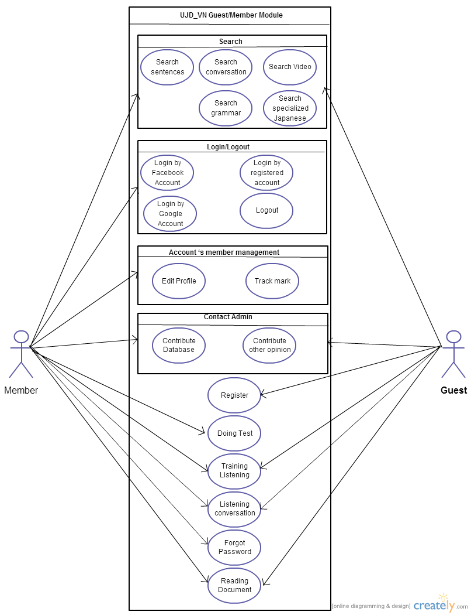
Use cases diagram

Slide 16
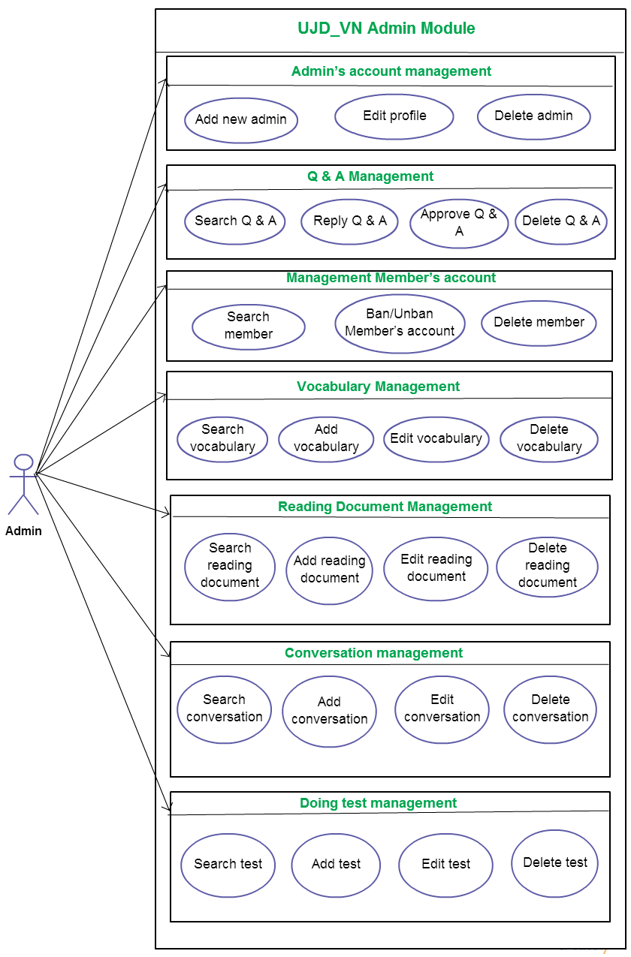

Slide 17


